Slide 1
White-box testing techniques
Dr. Durga Prasad Mohapatra
Professor, Dept. of CSE
N.I.T Rourkela
‹#›

Slide 2
White-box Testing
Designing white-box test cases:
  Requires knowledge about the internal structure of software.
  White-box testing is also called structural testing.
  In this unit we will study white-box testing.
‹#›

Slide 3
White-Box Testing Methodologies
There exist several popular white-box testing methodologies:
  Statement coverage
  Branch coverage
  Condition coverage
  MC/DC coverage
  Path coverage
  Data flow-based testing
  Mutation testing
‹#›

Slide 4
Statement Coverage
Statement coverage methodology:
  Design test cases so that every statement in the program is executed at least once.
‹#›

Slide 5
Statement Coverage
The principal idea:
  Unless a statement is executed,
  We have no way of knowing if an error exists in that statement.
‹#›

Slide 6
Statement Coverage Criterion
Observing that a statement behaves properly for one input value:
  No guarantee that it will behave correctly for all input values.
‹#›

Slide 7
Statement Testing
Coverage measurement:
# executed statements
# statements
Rationale: a fault in a statement can only be revealed by executing the faulty statement
‹#›
Notes:
12.2 STATEMENT TESTING

Slide 8
Example
int f1(int x, int y){
1 while (x != y){
2 if (x>y) then
3 x=x-y;
4 else y=y-x;
5 }
6 return x; }
Euclid's GCD Algorithm
‹#›

Slide 9
Euclid's GCD Algorithm
By choosing the test set {(x=3,y=3),(x=4,y=3), (x=3,y=4)}
  All statements are executed at least once.
‹#›

Slide 10
Branch Coverage
Test cases are designed such that:
  different branch conditions
    given true and false values in turn.
‹#›

Slide 11
Branch Coverage
Branch testing guarantees statement coverage:
  A stronger testing compared to the statement coverage-based testing.
‹#›

Slide 12
Stronger Testing
Test cases are a superset of a weaker testing:
  A stronger testing covers at least all the elements covered by a weaker testing.
‹#›

Slide 13
Stronger, Weaker, and Complementary Testing
Complementary
Weaker
‹#›

Slide 14
Example
int f1(int x,int y){
1 while (x != y){
2 if (x>y) then
3 x=x-y;
4 else y=y-x;
5 }
6 return x; }
‹#›

Slide 15
Example
Test cases for branch coverage can be:
{(x=3,y=3),(x=3,y=2), (x=4,y=3), (x=3,y=4)}
‹#›

Slide 16
Branch Testing
Adequacy criterion: Each branch (edge in the CFG) must be executed at least once
Coverage:
# executed branches
# branches
‹#›

Slide 17
Statements vs Branch Testing
Traversing all edges of a graph causes all nodes to be visited
  So test suites that satisfy the branch adequacy criterion for a program P also satisfy the statement adequacy criterion for the same program
The converse is not true
  A statement-adequate (or node-adequate) test suite may not be branch-adequate (edge-adequate)
‹#›
Notes:
The example of two slides ago illustrates this point

Slide 18
Condition Coverage
Test cases are designed such that:
  Each component of a composite conditional expression
    Given both true and false values.
‹#›

Slide 19
Branch vs Condition testing
Condition testing:
  Stronger testing than branch testing.
Branch testing:
  Stronger than statement coverage testing.
‹#›

Slide 20
Branch vs Condition testing
Branch testing is the simplest condition testing strategy:
  Compound conditions appearing in different branch statements
    are given true and false values.
‹#›

Slide 21
Multiple Condition Coverage
Multiple condition coverage reports whether every possible combination of Boolean sub-expressions occurs.
The test cases required for full multiple condition coverage of a condition are essentially given by the logical operator truth table for the condition.
‹#›

Slide 22
Multiple Condition Coverage cont …
Test cases are designed such that:
  each component of a composite conditional expression
    given both true and false values.
‹#›

Slide 23
Example
Consider the conditional expression
  ((c1.and.c2).or.c3):
Each of c1, c2, and c3 are exercised at least once,
  i.e. given true and false values.
‹#›

Slide 24
Multiple Condition Coverage Examples
if(A && B) // condition 1
F1();
else
F2();
if(C || D) // condition 2
F3()
else
F4();
Test Cases for MCC:
For condition 1 For condition 2
A=T, B=T C=T, D=T
A=T, B=F C=T, D=F
A=F, B=T C=F, D=T
A=F, B=F C=F, D=F
‹#›

Slide 25
MCC Testing Adequacy Criterion
Adequacy criterion: Each basic condition must be executed at least once
Coverage:
# truth values taken by all basic conditions
2 * # basic conditions
‹#›
Notes:
the total number of truth values that the basic conditions can take is twice the number of basic conditions, since each basic condition can assume value true or false

Slide 26
Branch Testing vs MCC Testing
Multiple Condition Coverage testing:
  Stronger testing than branch testing.
Branch testing:
  Stronger than statement coverage testing.
‹#›

Slide 27
Need of a Feasible Testing Technique
Consider a boolean expression having n components:
  For condition coverage we require 2^{n} test cases. (example in next slide)
Condition coverage-based testing technique:
  Practical only if n (the number of component conditions) is small.
‹#›

Slide 28
MCC
Consider: if (a || b && c) then …
Test a b c
(1) T T T
(2) T T F
(3) T F T
(4) T F F
(5) F T T
(6) T T F
(7) F F T
(8) F F F
Exponential in the number of basic conditions

Slide 29
Modified condition/decision (MC/DC)
Motivation: Effectively test important combinations of conditions, without exponential blowup in test suite size
  “Important” combinations means: Each basic condition shown to independently affect the outcome of each decision
Requires:
  For each basic condition C, two test cases,
  values of all evaluated conditions except C are the same
  compound condition as a whole evaluates to true for one and false for the other
‹#›
Notes:
If we don’t want to test all possible combinations, then we have to say which combinations are important.
One good choice is to choose combinations that show how each basic condition can affect the outcome,
i.e., how changing that one condition can change the value of the whole compound condition. That’s
what the “modified condition/decision” criterion requires.

Slide 30
What is MC/DC?
MC/DC stands for Modified Condition / Decision Coverage
A kind of Predicate Coverage technique
  Condition: Leaf level Boolean expression.
  Decision: Controls the program flow.
Main idea: Each condition must be shown to independently affect the outcome of a decision, i.e. the outcome of a decision changes as a result of changing a single condition.
‹#›

Slide 31
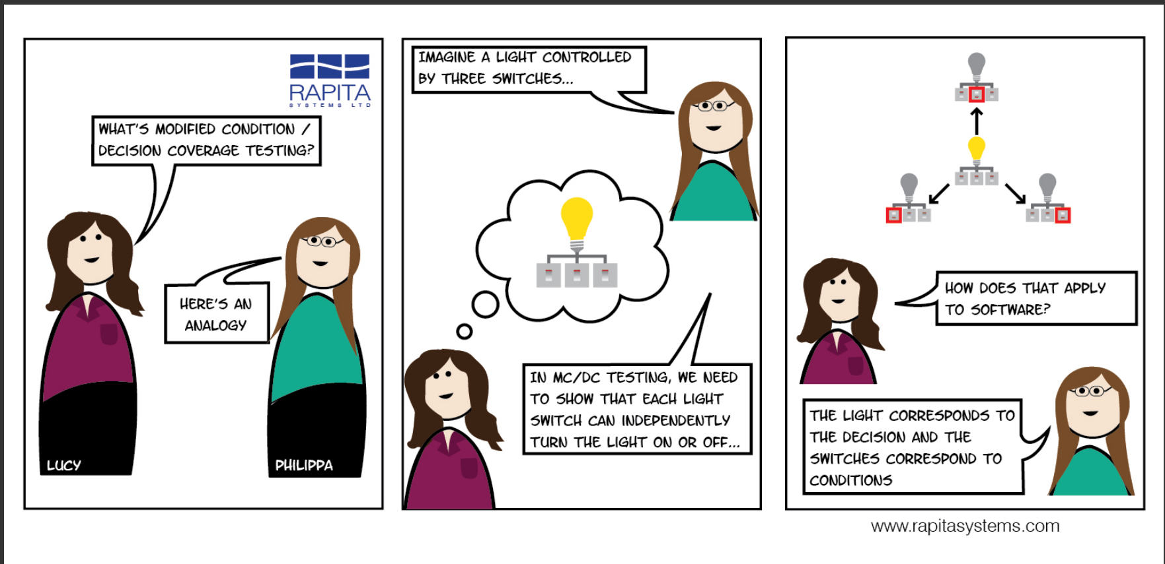
‹#›

Slide 32
Condition Coverage
Every condition in the decision has taken all possible outcomes at least once.
If ((a) & (b) | (c)) then…
&
|
true
false
true
false
true
false
‹#›

Slide 33
MC/DC Coverage
Every condition in the decision independently affects the decision’s outcome.
If ((a) && (b) || (c)) then…
true
false
true
false
Change the value of each condition individually while keeping all other conditions constant.
‹#›

Slide 34
MC/DC: linear complexity
N+1 test cases for N basic conditions
(((a || b) && c) || d) && e
Test a b c d e outcome
Case
(1) true -- true -- true true
(2) false true true -- true true
(3) true -- false true true true
(6) true -- true -- false false
(11) true -- false false -- false
(13) false false -- false -- false
Underlined values independently affect the output of the decision
Required by the RTCA/DO-178B standard
‹#›
Notes:
This is the same table as two slides ago, omitting redundant cases.
Cases 4,5, 7-10, and 12 have been omitted.
In each column we find two rows in which that column is underlined. For example, the “a” column
is underlined in rows (1) and (13). All the evaluated conditions in those two rows are the same
except for that column. For example, to show that changing “a” from true to false in case (1) would
change the outcome, we
* Fill in the “don’t care” columns in row 1 with values from row 13 (because this doesn’t change
anything
* Then see that the rows are completely identical except in column “a” and the outcome
so clearly changing the value of “a” changed the outcome.
The number of test cases needed is hardly more than for basic condition coverage, but MC/DC is
much better than basic condition coverage at exposing faults in conditional expressions, so it is
clearly superior (and therefore very widely used, and specified in some standards).

Slide 35
Comments on MC/DC
MC/DC is
  basic condition coverage (C)
  branch coverage (DC)
  plus one additional condition (M):
  every condition must independently affect the decision’s output
It is subsumed by compound conditions and subsumes all other criteria discussed so far
  stronger than statement and branch coverage
A good balance of thoroughness and test size (and therefore widely used)
‹#›
Notes:
(This mainly restates comments on the previous slide, and can be used
or skipped depending on lecture style)

Slide 36
Example
If (A && B) then…
(1) create truth table for conditions.
(2) Extend truth table so that it indicated which test cases can be used to show the independence of each condition.
A B | Result
T T | T
T F | F
F T | F
F F | F
Number | A B | Result | A | B
1 | T T | T | 3 | 2
2 | T F | F |  | 1
3 | F T | F | 1
4 | F F | F
‹#›
Notes:
(T,T) test is required as it is the only one that returns true
(F,T) test is required as it is the only test that changes the value of only A and also changes the decision's outcome, thereby establishing the independence of A In similar fashion
(T,T) and (T,F) tests are required to show the independence of B.
Test set {(T,T), (T,F), (F,T)} satisfies MC/DC for the expression A and B.

Slide 37
Example cont …
Show independence of A:
  Take 1 + 3
Show independence of B:
  Take 1 + 2
Resulting test cases are
  1 + 2 + 3
  (T , T) + (T , F) + (F , T)
Number | A B | Result | A | B
1 | T T | T | 3 | 2
2 | T F | F |  | 1
3 | F T | F | 1
4 | F F | F
‹#›

Slide 38
More advanced example
If (A && (B || C)) then…
Number | A B C | Result | A | B | C
1 | T T T | T | 5
2 | T T F | T | 6 | 4
3 | T F T | T | 7 |  | 4
4 | T F F | F |  | 2 | 3
5 | F T T | F | 1
6 | F T F | F | 2
7 | F F T | F | 3
8 | F F F | F
‹#›

Slide 39
More advanced example contd..
Note: We want to determine the MINIMAL set of test cases
Here:
{2,3,4,6}
{2,3,4,7}
Non-minimal set is:
{1,2,3,4,5}
‹#›

Slide 40
Where does it fit in?
The MC/DC criterion is much stronger than the condition/decision coverage criterion, but the number of test cases to achieve the MC/DC criterions still varies linearly with the number of conditions n in the decisions.
  Much more complete coverage than condition/decision coverage, but
  at the same time it is not terribly costly in terms of number of test cases.
Multiple-condition
all paths
Modified condition/decision
all-du-paths
Condition/Decision
all uses
Decision
reach
Statement
Condition
‹#›

Slide 41
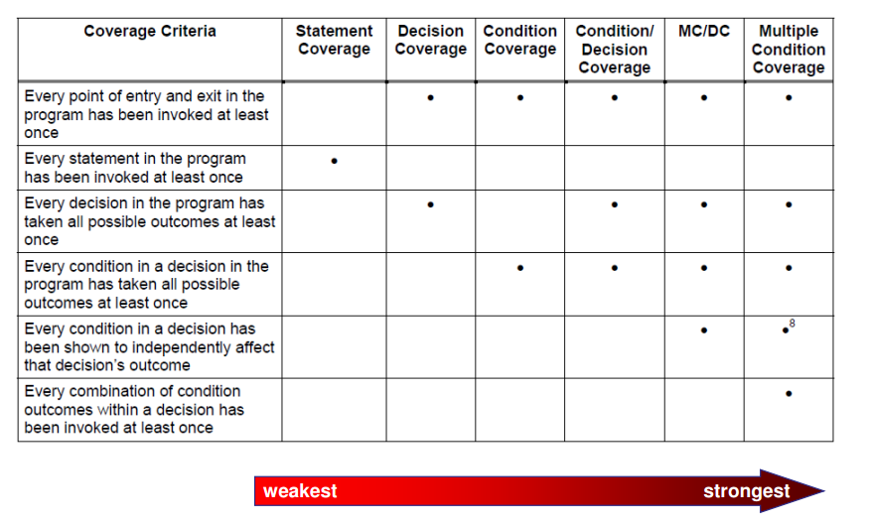
Comparison of different coverage based Testing Strategies
‹#›

Slide 42
Summary
Discussed white-box test case design using:
  Statement coverage technique
  Branch coverage technique
  Condition coverage technique
  MC/DC technique
‹#›

Slide 43
References
Rajib Mall, Fundamentals of Software Engineering, (Chapter – 10), Fifth Edition, PHI Learning Pvt. Ltd., 2018.
Naresh Chauhan, Software Testing: Principles and Practices, (Chapter – 5), Second Edition, Oxford University Press, 2016.

Slide 44
Thank You
‹#›

